Slide 1
Simple interest
Choose your Own Adventure
Ms. Latham
Year 9

Slide 2
You will……
Choose your own
Career
Car
House
Weekly budget
And determine if you can sustain your ideal life style with your remaining budget
You need a Choose Your Destiny WS and calculator to be successful

Slide 3
1. Career
Estimates based on current local (No FIFO) WA job ads, full time (40 hours a week)
Job | Vet | Truck Driver | Engineer | Retail Worker
Amount of study | >5 years | Training course | >5 years | none
Responsibility level | High | Medium | High | Low
Annual Pay | $82,000 | $55,000 | $110,000 | $38,000
Choose a career and fill in the section on your WS, then calculate your weekly pay.

Slide 4

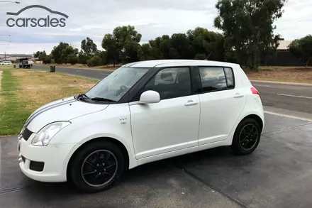
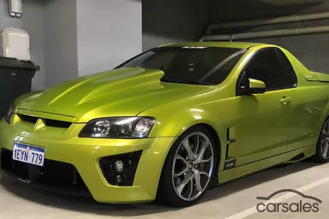
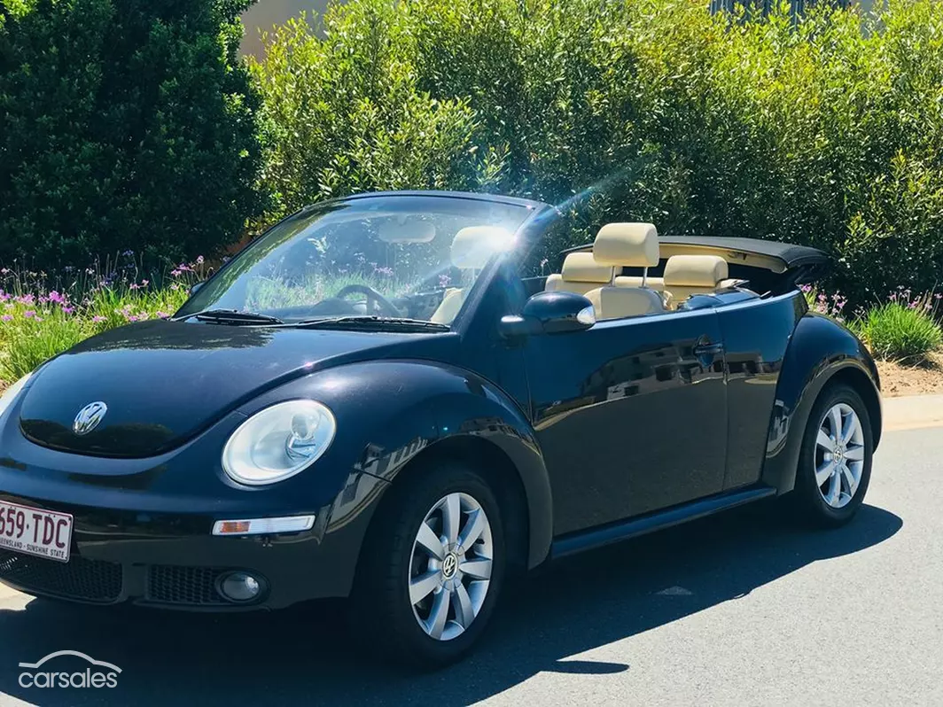
2. Car
Estimates based on current local Australian car sales, carsales.com.au and Redbook.com.au
Make/Model | Porsche Cayman | Suzuki Swift | Holden Maloo R8 | Volkswagen Beetle
Year | 2017 | 2009 | 2008 | 2010
Used/New | New | Used | Used | Used
Cost | $115,000 | $5,000 | $35,000 | $17,000
Choose a car and choose a loan length (3, 5, or 10 years). Calculate simple interest and total to pay over then loan length. Then find weekly payment.

Slide 5
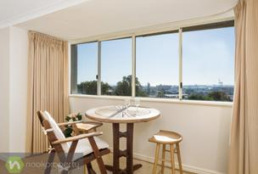
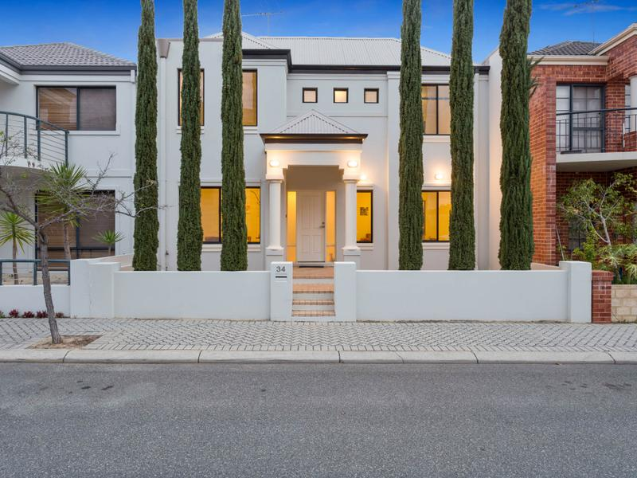
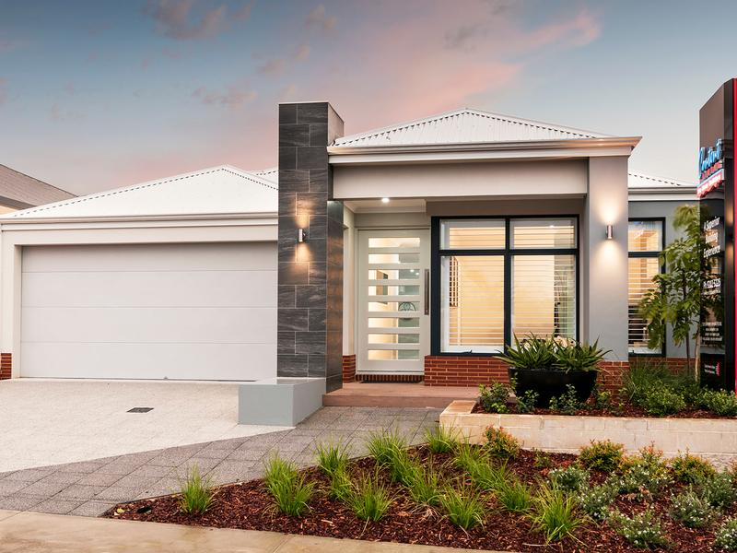
3. Home
Estimates based on current local ads, realestate.com.au
Type | Apartment | House | House
Bathrooms/Rooms | 1 / 1 | 2 / 3 | 2 / 4
Outside Space | none | small | medium
Location | Fremantle | East Perth | Baldivis
Cost | $405,000 | $1,200,000 | $380,000
Choose a home (everyone will use the standard 30 – year mortgage) calculate simple interest, total to pay, and weekly mortgage payments.

Slide 6
4. Expenses and life style
Weekly Pay $$$$$
Weekly Car Payments
─ Weekly House Payments
Remaining amount
Brainstorm with others what other expenses there might be?
Examples: insurance, fuel, food, activities, shopping, traveling, pets……
What kind of life style can you afford?
Luxury…….. (traveling, meals out, shopping)
Moderate….. (some traveling, occasional meals out and shopping)
Basic……………… (no traveling, no shopping or meals out)

Slide 7
Reflection
What would you do differently next time?
What surprised you about the simple interest values?

